Slide 1
What is PID & Pursuit Algorithms?
By Junaet Mahbub

Slide 2

P.I.D (Proportional-Integral-Derivative)
These 3 define 3 kinds of personality that together adjust a control output.
Imagine going too fast: e.g (error = target – actual speed is positive) and a car that adjusts to the increase/decrease in speed
Now let’s say a car is consistently under 2mph below its target speed- calculating the integral of that accumulates past error and adds more throttle to make up for it
Derivative control looks at your error’s rate of change (how fast you’re speeding up) – it applies forces in opposition to slow down (brakes)
Notes:
2) Proportional Control – output adjusts in proportion to the current error- how wrong are we at this moment
3) Integral Control – integral control is more like memory and it sums up error over time – which helps us calculate correction paths – or potentially overshoot
4) Derivative control - output adjusts based on the rate of change of the error. It’s the “future predictor” – essentially the slope of the error curve. Too much change in the slope results in slow opposite forces acting – or it can become too sensitive like an ultrasonic sensor that reads at a large distance.
error = setpoint - current_value
integral += error * dt # accumulate error over time
derivative = (error - prev_error) / dt # change in error
output = Kp*error + Ki*integral + Kd*derivative
prev_error = error
FOR ME ONLY
P is impatient and corrects right now, but might not get you perfectly on course (he stops a bit short).
I is the persistent one who notices “we’ve been off for a while” and nudges you further to eliminate the leftover error.
D is cautious, watching “how fast are we approaching the target?” and telling everyone to slow down if we’re closing in too quickly.
Tuning a robot for Pid means balancing these personlaities

Slide 3
Pursuit Algorithms
Pursuit algorithms are a combination of both kinematics, frames, and control to become a trajectory tracking problem – in other words we assign several coordinates to follow.
It is popular for lateral control (think a car can’t strafe to the right, you need to turn the wheel laterally) , and the robot essentially chases to the next point.
When driving a car we don’t look at the pedals and drive: we look at our surroundings from a distance and observes for any changes in the environment (at least a safe driver does) vs a donkey chasing a carrot.
The distance from which we observe changes our reaction time (Look Ahead Principle)

Slide 4
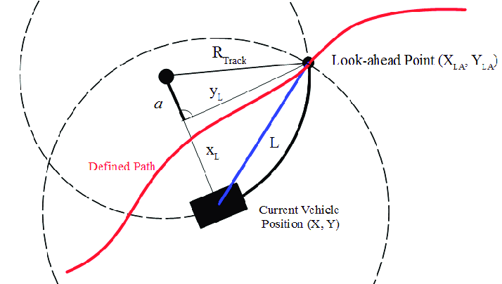


How Pure Pursuit Works
At the current position, imagine a circle of radius R, a zone. The goal is to label a coordinate on a frame and have that zone and that point on the coordinate system intersect.
The intersection of that forms a radius as soon as the circle touches the point and thus forms a path non-linearily (think centripetal force, we curve to the target) and a target point to pursue – we form and arc path.
Repeat for continuous stabilization of path – creating a feedback loop – maintaining speed and applying a steering angle.

Slide 5
Show Python Example

